Slide 1

Fluency / Facility Subtests on the KTEA 3
Denise DeLoria, Elementary SPED Instructional Coach
Denise_deloria@chino.k12.ca.us
Teresa Lackey, Secondary SPED Instructional Coach
Teresa_lackey@chino.k12.ca.us
Notes:
In this section of Special Education Assessments we are going to be looking at the different fluency and facility subtests.

Slide 2
Learn
Learning Outcomes
For the subtests:
Writing Fluency, Silent Reading Fluency, Math Fluency, Associational Fluency, Object Naming Facility, Letter Naming Facility, Word Recognition Fluency, and Decoding Fluency
How to identify the Basal and Ceiling
How to Score the subtests
Notes:
We are going to look at the different fluency and facility subtests in the KTEA. We will look at how to identify the basal and the ceiling and how to score the subtests.

Slide 3



KTEA-3 Record Form
Used for scoring
Can be Form B or Form A (blue)
Notes:
This is the record form. It will be used to score all your subtests.

Slide 4
KTEA-3 Response Booklet
This will be used with only the tests listed on the front.
Students write in this booklet
Notes:
This is the response booklet the student will use this for the writing fluency subtest starting on page 11, silent reading fluency subtest starting on page 19, and math fluency subtest starting on page 26.

Slide 5



WRITING FLUENCY
This Photo by Unknown Author is licensed under CC BY-NC
Notes:
Let’s look at Writing Fluency

Slide 6
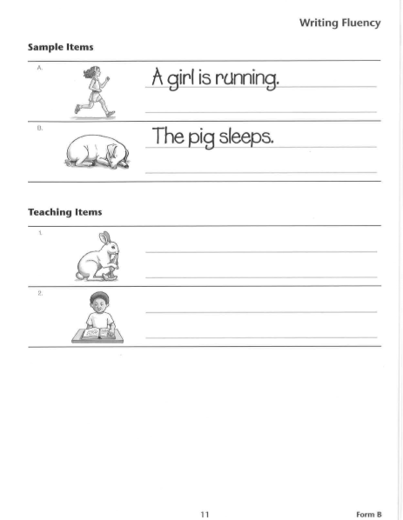
Notes:
This page is found in the Response Booklet and the writing fluency subtest begins on page 11. As you can see you have two sample items to use as an example and you have two teaching items to allow the student to practice. It is very important that you make every effort to ensure the student understands what he is being asked to do.

Slide 7
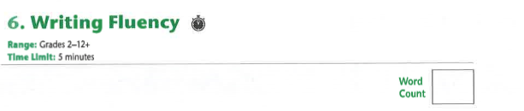
WRITING FLUENCY
Notes:
This subtest can be given to students in grades 2 – 12+. . The writing fluency subtest will require you to use a stopwatch because the time limit is 5 minutes. The raw score is the total number of recognizable words written by the student within the time limit. Do not penalize for poor letter formation, or errors in spelling, punctuation, capitalization, or grammar. Refer to the Scoring Manual on page 17 for detailed scoring rules and examples.

Slide 8

SILENT READING FLUENCY
This Photo by Unknown Author is licensed under CC BY-NC-ND
Notes:
Now let’s discuss the silent reading fluency subtest

Slide 9
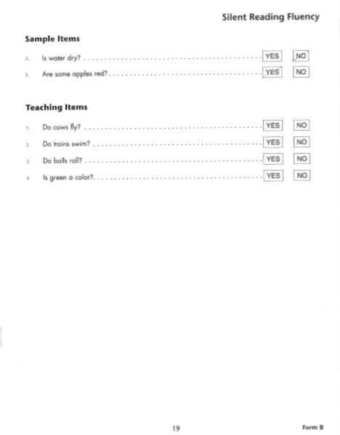
SILENT READING FLUENCY
Notes:
This subtest is found in the response booklet beginning on page 19. This subtest is for grades 1 – 12+. The start point will be with sample A. Teaching is especially important on this subtest. When administering the sample and teaching times, make every effort to ensure the student understands what he is being asked to do. During testing make sure the student is answering the questions in sequence.

Slide 10
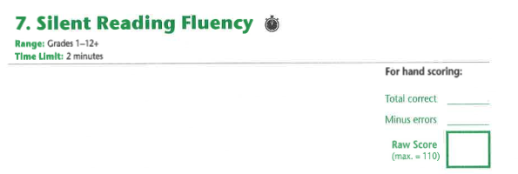
Notes:
You will also need a stopwatch for this subtest. The student will be given exactly 2 minutes to complete as many items as possible. Enter in the number of total correct into Q-Global.

Slide 11
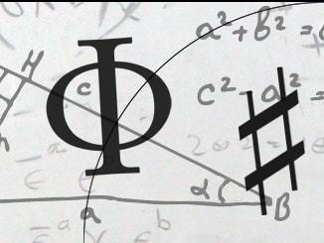
Math Fluency
This Photo by Unknown Author is licensed under CC BY-NC-ND
Notes:
Now let’s look at math fluency

Slide 12
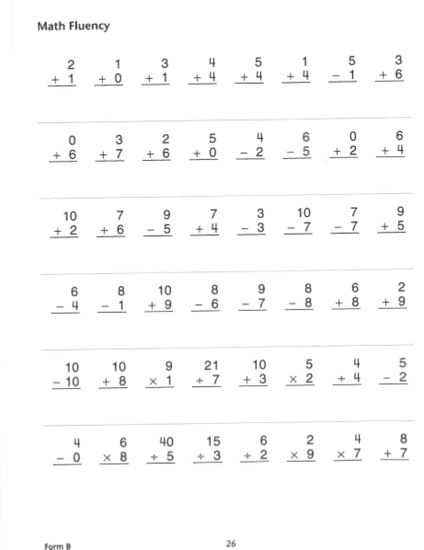
Notes:
The math fluency subtest can be found in the student response booklet beginning on page 26. The start point for this subtest is with item 1. You will need a stopwatch with this test and the student is to be given exactly 1 minute to complete as many items as possible. If the student doe not attempt the problems in order (left to right, row by row, left page first), immediately redirect him but do not stop timing. After timing begins, do not remind the student to watch the sign of operation.

Slide 13
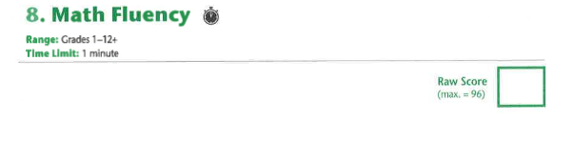
Notes:
This test can be given to students in grades 1-12+. Simply enter the item responses into Q-Global for automated scoring.

Slide 14
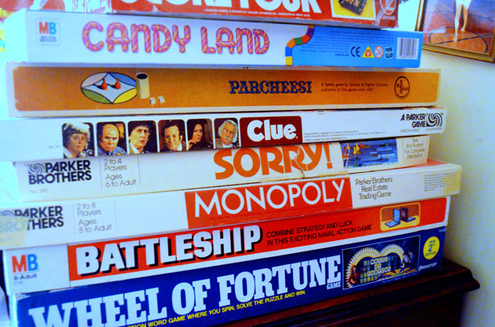
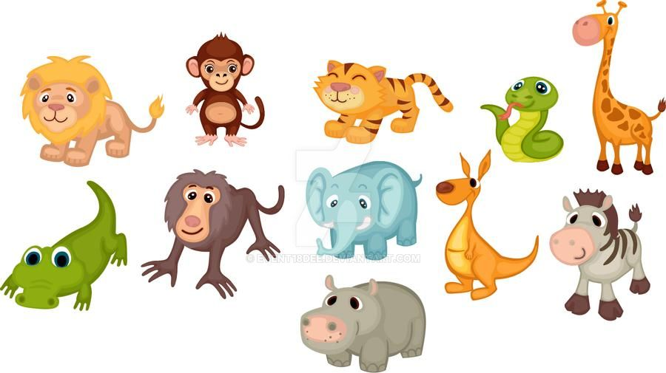
Associational Fluency
This Photo by Unknown Author is licensed under CC BY-NC-ND
Notes:
Let’s take a look at associational fluency

Slide 15
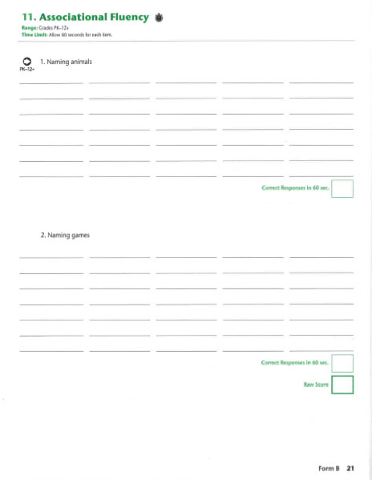
Notes:
You will need a stopwatch with this test and the student is to be given exactly 1 minute for each section. An audio recorder is recommended to facilitate recording and scoring of this test.

Slide 16

Notes:
The associational fluency test can be given to students in grades PK-12+. To calculate the raw score for each section, sum the number of different responses spoken by the student within the time limit. Refer to the Scoring Manual on page 15 for detailed scoring criteria and examples.

Slide 17

OBJECT NAMING FACILITY
This Photo by Unknown Author is licensed under CC BY-SA
Notes:
Now on to the object naming facility subtest

Slide 18
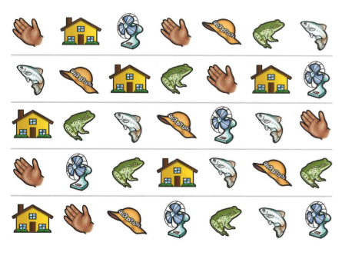
Notes:
Here is an example of the subtest from the stimulus book. You can give this subtest to a student in grades PK – 12+, start with the practice items, and then complete trial 1 and trial 2. For this subtest you will need a stopwatch. Use the stopwatch to time how long it takes the student to name all of the objects on the page for each trial. When administering the practice items, teach and rephrase the instructions as needed to ensure the student understands what he is being asked to do. If the student uses a different name for an object, tell him what name to use. If the student loses his place or skips a row during a trial, immediately redirect him by pointing to the appropriate place on the stimulus book page, but do not stop timing.

Slide 19
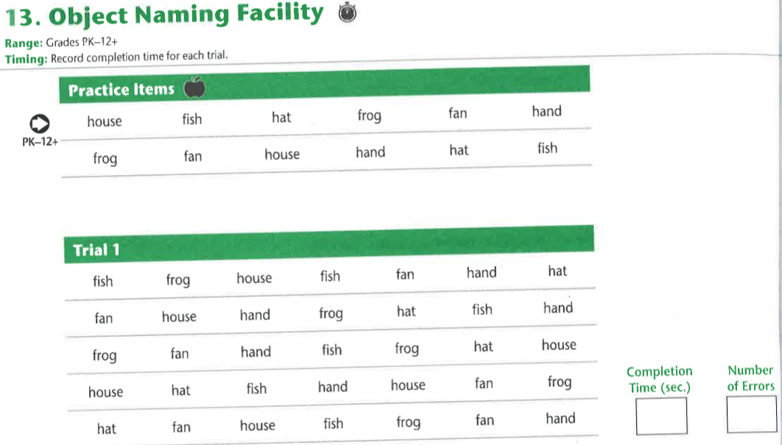
Notes:
When scoring count the number of errors but accept any reasonable synonyms as correct. Do not count self-corrections or repetitions as errors. Record the completion time in seconds for each trail.

Slide 20
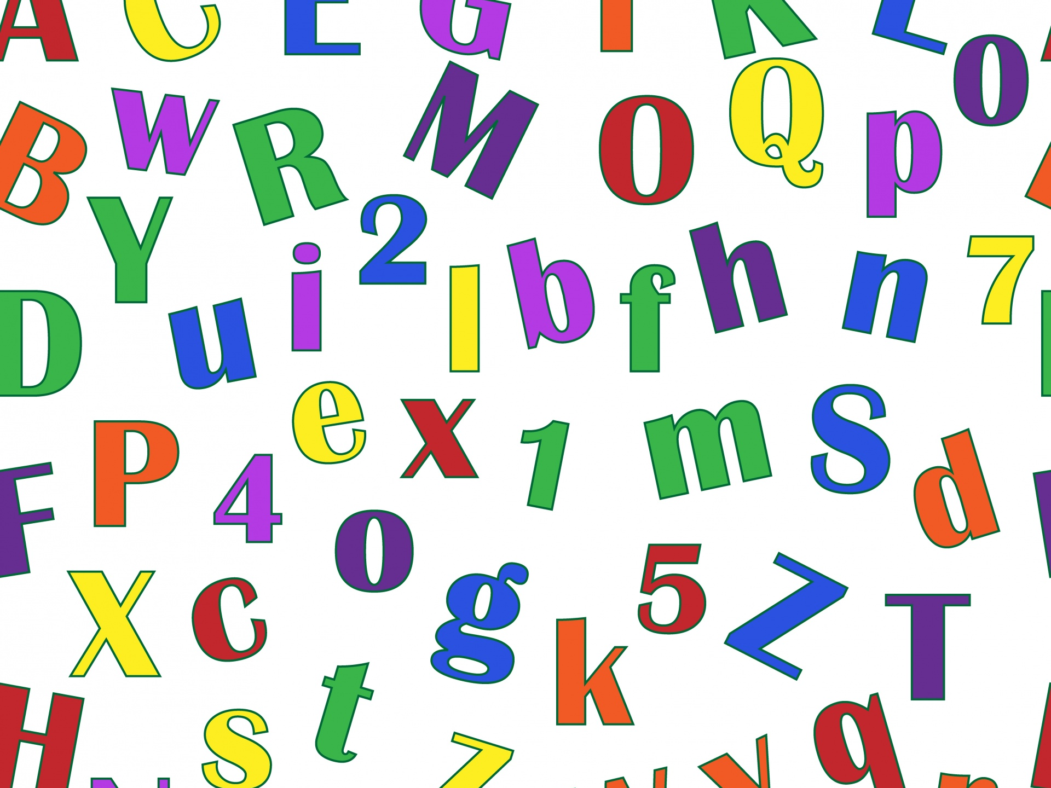
LETTER NAMING FACILITY
Notes:
Now on to the letter naming facility

Slide 21
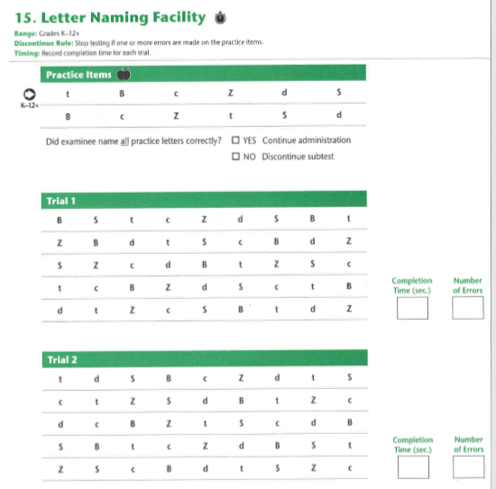
Notes:
For the letter naming facility subtest you will need a stopwatch. When administering the practice items, teach and rephrase the instructions as needed to ensure the student understands what he is being asked to do. This subtest can be given to students in grades K-12+.

Slide 22
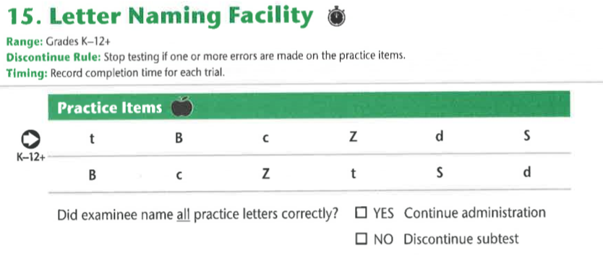
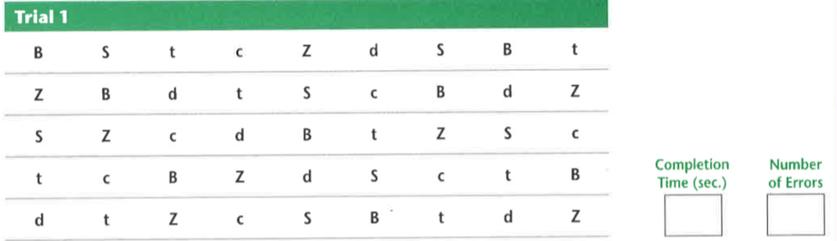
Notes:
Start with the practice items and then complete trial 1 and trial 2. Stop testing if one or more errors are made on the practice items. Record the number of errors made on each trail. Do not count self corrections or repetitions as errors. Use the stopwatch to time how long it takes the student to name all the letters on the page for each trial.

Slide 23

WORD RECOGNITION FLUENCY
This Photo by Unknown Author is licensed under CC BY-SA
Notes:
On to word recognition fluency

Slide 24
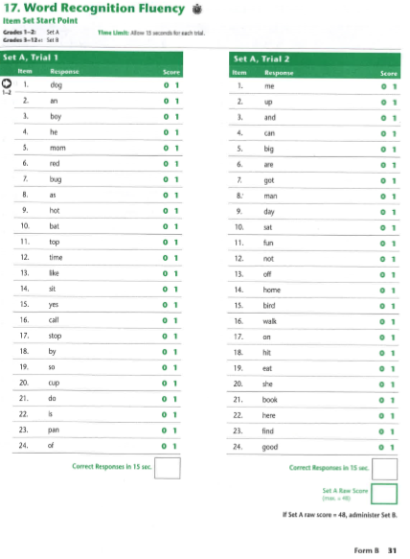
SET A TRIAL 1
SET A
TRIAL 2
Notes:
You will need a stopwatch for this trial. Do not give this subtest before giving Letter & Word Recognition. Before administering this subtest for the first time, listen to the audio file to hear how the more difficult words should be pronounces. Items are grouped into sets. Set A is recommended for grades 1-2 where set B is recommended for grades 3-12+. Encourage the student to keep going if he hesitates or seems to get stuck on a word. If the student loses his place or skips a row, immediately redirect him by pointing to the appropriate place on the stimulus book page , but do not stop timing.

Slide 25
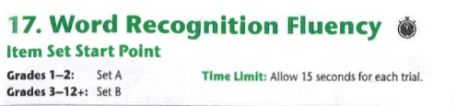
Notes:
This subtest has a 15 second time limit for each trial. If giving set A and the raw score is 48 then also give set B. If giving set B and trial 1 has a raw score of 2 or less then drop back to set A. The raw score is the number of words read correctly within the time limit. Do not penalize for articulation differences die to dialect, regional speech patterns. Or a first language other than English.

Slide 26

This Photo by Unknown Author is licensed under CC BY-NC-ND
DECODING FLUENCY
Notes:
Now for the final subtest, decoding fluency

Slide 27
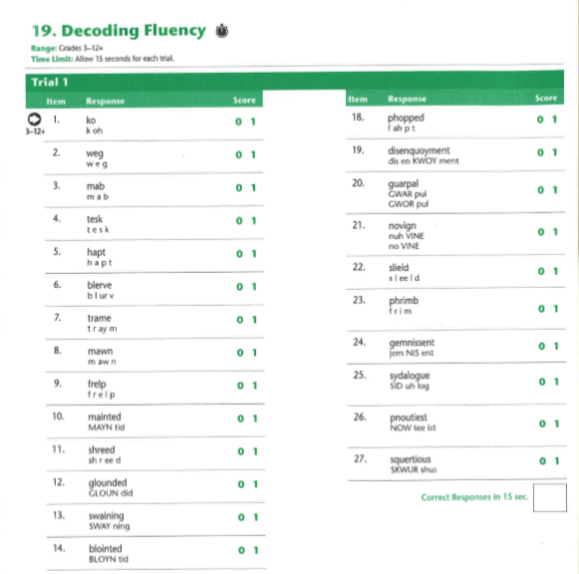
Notes:
This subtest can be given to students in grades 3-12+, start with trial 1 and then complete trial 2. For the decoding fluency subtest you will need a stopwatch. Do not give this subtest before giving Nonsense Word Decoding. Before administering this subtest for the first time, listen to the audio file to hear how the nonsense words should be pronounces. If the student gets stuck on a work or hesitates at the end of a row encourage him to continue. If the student loses his place or skips a row, immediately redirect him by pointing to the appropriate place on the stimulus book page, but do not stop time.

Slide 28
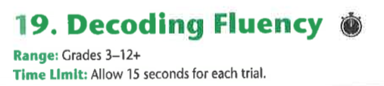
Notes:
For each trial give exactly 15 seconds. The raw score is the number of nonsense words read correctly within the time limit. Do not penalize for articulation differences due to dialect, regional speech patterns, or a first language other than English.

Slide 29

denise_deloria@chino.k12.ca.us
Elementary Special Education Instructional Coach
teresa_lackey@chino.k12.ca.us
Secondary Special Education Instructional Coach
Notes:
Thank you for your time and please feel free to contact either one of us if you have any questions or concerns.

